Slide 1
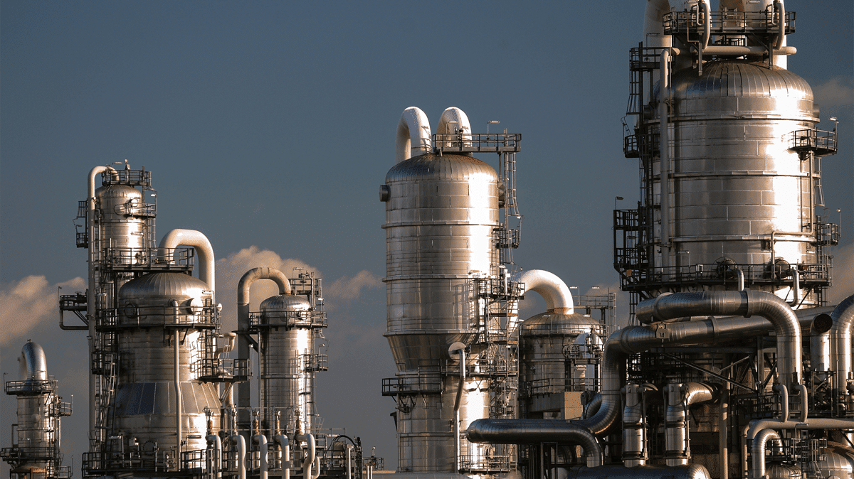

BUSINESS PROFILE
Modern Business Presentation Template
Where Passion and Productivity Meet
www.imaniinorganics.com

Slide 2
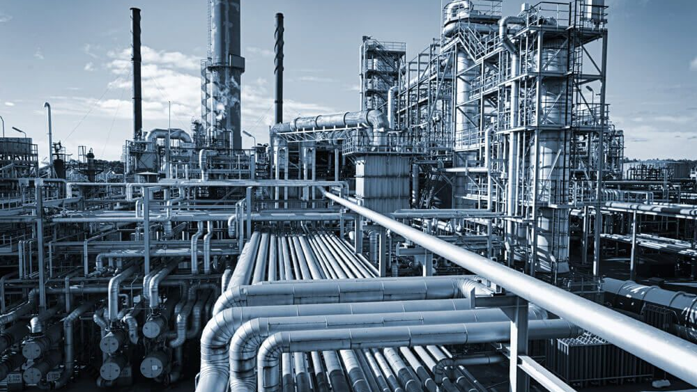
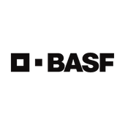
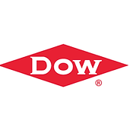
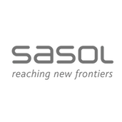
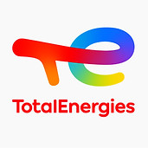
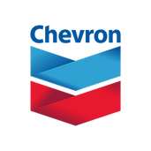

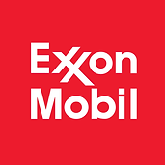
IMANI INORGANICS
Where passion meets productivity
Imani Inorganics is a B-BBEE level 4 certified company which has built a presence in Europe, Saudi Arabia, Dubai, India, USA, Canada and many countries throughout Africa, supporting the needs of multinational conglomerates since 2018.
We are supported by companies such as Exxon Mobil, Total Energies, Sasol and Omnia
We assist our clients with secured supply on specialized mining and water treatment chemicals, quality control, and more. Imani Inorganics prides itself on its excellent ability to solve problems and provide affordable, efficient resolutions for any prevailing local shortages.
Imani Inorganics aims to be a pioneering force in South Africa's chemical industry, providing premium solutions for mining and water treatment. Our quality-focused approach establishes us as a trusted partner, enhancing client efficiency. We aspire to excel globally, linking mining with green energy via local exports and international collaborations. Social responsibility stands as a core value at Imani Inorganics; supporting organizations like Usizo Lomndeni, who strive to nourish countless children daily showcases our commitment to community well-being.
OUR PARTNERS

Slide 3
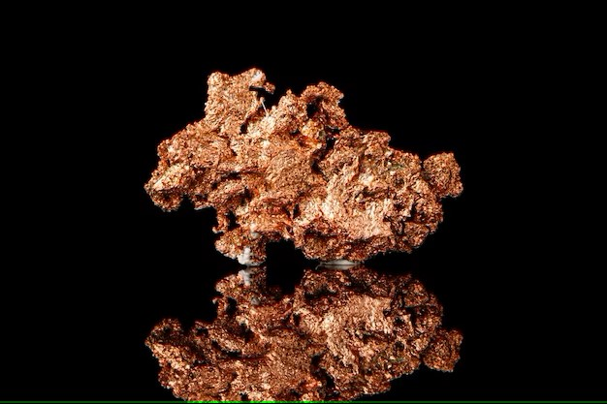
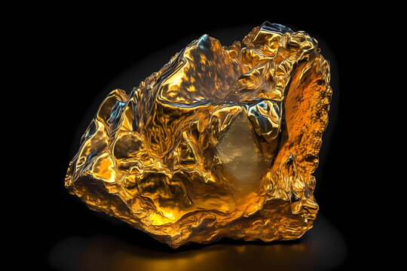
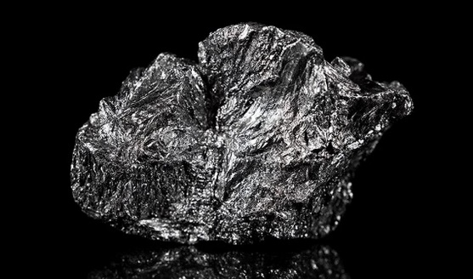
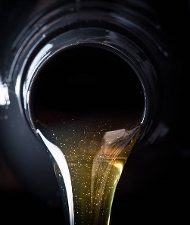
CORE SECTORS
MINING CHEMICALS
Copper & Cobalt extraction
Gold Floatation
Iron ore
Burner fuels
Hydrochloric acid 33%
Sodium cyanide Briquettes
Activated carbon
Kerosene
MIBC
Nitric Acid
Citric Acid
Sodium Hydroxide.
Sulfuric acid
Granular Sulphur
Copper Sulphate
HFO (Heavy fuel oil)
At Imani, we ensure quality in accordance with the highest international standards and hold direct mandates and legal offtake agreements with Coal, Lithium, Gold and Iron ore mines across Africa.

Slide 4
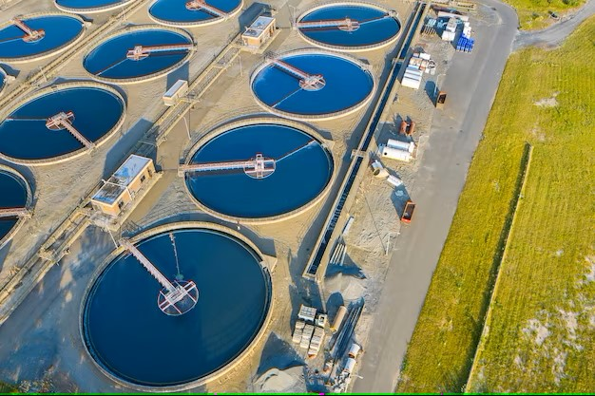
CORE SECTORS
WATER TREATMENT
Coagulants
Locally Produced flocculants
Water treatment
Chlorine
Calcium hypochlorite
Sodium hypochlorite
Sodium hydroxide
Phosphoric acid
Hydrochloric Acid
Chlorine dioxide
Sodium Bromide
Caustic lye
Ferric Sulphate
Aluminium Sulphate
Ferric Chloride
RCFloc 54
RCFloc 50
RCFloc 41
Please request spec sheets to determine which of our flocculants will best suit your needs
Copper & Cobalt extraction
Gold Floatation
Iron ore
Hydrochloric acid 33%
Sodium cyanide Briquettes
Activated carbon
Kerosene
MIBC
Nitric Acid
Citric Acid
Sodium Hydroxide.
Sulfuric acid
Granular Sulphur
Copper Sulphate
Imani Inorganics stands as the chosen partner for the largest multinational water treatment companies in South Africa!
Our commitment to excellence and innovation has earned us the trust of industry leaders, and we're honored to uphold that trust.
At Imani, we ensure quality in accordance with the highest international standards and hold direct mandates, shares and legal offtake agreements with Coal, Lithium, Gold and Iron ore mines across Africa.

Slide 5
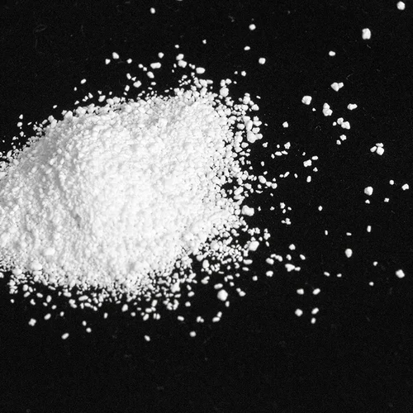
CORE SECTORS
SODIUM CARBONATE
Water treatment
PH Control
Glass Manufacturing
Chlorine
Calcium hypochlorite
Sodium hypochlorite
Sodium hydroxide
Phosphoric acid
Hydrochloric Acid
Chlorine dioxide
Sodium Bromide
Caustic lye
Soda ash solution
Soda ash light
Soda ash dense
Solvay material
Synthetically produced : SAD/SAL
Naturally mined:
Wyoming green river
Kenya
Copper & Cobalt extraction
Gold Floatation
Iron ore
Hydrochloric acid 33%
Sodium cyanide Briquettes
Activated carbon
Kerosene
MIBC
Nitric Acid
Citric Acid
Sodium Hydroxide.
Sulfuric acid
Granular Sulphur
Copper Sulphate
Imani Inorganics holds accounts with four of the five major producers worldwide, revering soda ash as our core product we pride ourselves in being able to offer our clients the best of both synthetically produced and naturally mined sodium carbonate.
At Imani, we ensure quality in accordance with the highest international standards and hold direct mandates, shares and legal offtake agreements with Coal, Lithium, Gold and Iron ore mines across Africa.

Slide 6
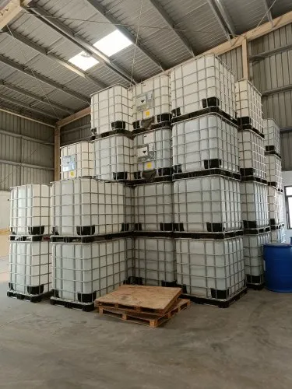
STORAGE & DECANTING
SOLUTION
HYDROCHLORIC ACID
CONTAINER SOLUTION
STORAGE
SOLUTION
Through our collaboration with CatCon,and the new body corporate of Transet’s inland railway line, we fortify our commitment to seamless operations. This partnership ensures that your imports are not only fast-tracked but also protected against potential delays. With CatCon’s expertise in risk mitigation, you can rest assured knowing your shipments are in capable hands, added benefits include:
Demurrage free Imports
Bulk handling
Container terminal 1/km from facility
Terminal 2 stop – Inland Railway, situated 500 meters from our site
Container Turn ins within 48 hours
Storage capacity for over 1000/MT of HCL in 1150/kg IBC containers
1000 square meters of concrete yard area with industrial zoning for decanting
Collaboration with Klia – Fully licenced decanting company with chemical engineers and state of the art pumping equipment on site
Weighbridge - onsite
Professional team available for stock control and administering of POD’s and delivery notes from Monday – Friday 8:00 – 16:30
Water treatment
Chlorine
Calcium hypochlorite
Sodium hypochlorite
Sodium hydroxide
Phosphoric acid
Hydrochloric Acid
Chlorine dioxide
Sodium Bromide
Caustic lye
Copper & Cobalt extraction
Gold Floatation
Iron ore
Hydrochloric acid 33%
Sodium cyanide Briquettes
Activated carbon
Kerosene
MIBC
Nitric Acid
Citric Acid
Sodium Hydroxide.
Sulfuric acid
Granular Sulphur
Copper Sulphate
At Imani, we ensure quality in accordance with the highest international standards and hold direct mandates, shares and legal offtake agreements with Coal, Lithium, Gold and Iron ore mines across Africa.
Imani Inorganics prides itself in our Cato Ridge state of the art facility, being the first of three facilities we planned to establish in 2023 to combat pain points in our clients Hydrochloric Acid supply chain.

Slide 7
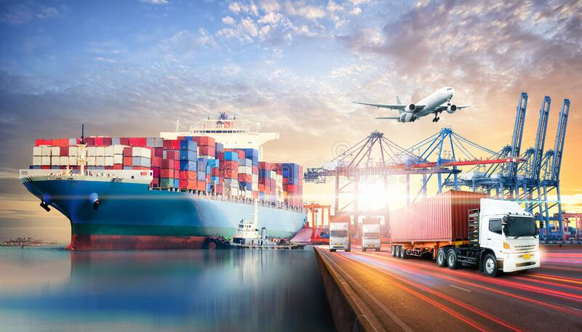
GLOBAL FOOTPRINT
ADDING VALUE TO YOUR SUPPLY CHAIN
Exports
Brazil
Panama
Ecuador
UK
DRC
UAE
Mozambique
Copper & Cobalt extraction
Gold Floatation
Iron ore
Hydrochloric acid 33%
Sodium cyanide Briquettes
Activated carbon
Kerosene
MIBC
Nitric Acid
Citric Acid
Sodium Hydroxide.
Sulfuric acid
Granular Sulphur
Copper Sulphate
Imani Inorganics is a leading global supply chain specialist with allocations worldwide with leading producers we ensure seamless service delivery, fully insured to your nearest port.
Our promise is simple: wherever your business operates, we're there with you every step of the way.
At Imani, we ensure quality in accordance with the highest international standards and hold direct mandates, shares and legal offtake agreements with Coal, Lithium, Gold and Iron ore mines across Africa.

Slide 8
DUTY FREE IMPORTS:
OUR TRADE AGREEMENTS
Insert Your Great Subtitle Here
GOBAL PARTNERSHIPS
Countries that benefit:
Based in South Africa, Imani Inorganics brings you a unique advantage that sets us apart in the global market. As a part of the BRICS family – Brazil, Russia, India, China, and South Africa – we offer our clients from these relevant BRICS countries a remarkable opportunity to import from us entirely duty-free.
Imagine the possibilities: By choosing Imani Inorganics, you're not only gaining access to top-tier products and solutions, but you're also saving significantly on import taxes. Our duty-free advantage gives you a competitive edge and allows you to allocate resources where they matter most – in growing your business.
Imani Inorganics is more than a business partner; we're a facilitator of growth and a catalyst for international success. Our South African base opens doors to a world of opportunities, where business knows no boundaries. Join us in shaping a future where cross-border partnerships flourish and innovation knows no limits.
Experience the Imani Inorganics advantage today – where duty-free imports and hassle-free business meetings redefine the way you do business across borders.
SADC – South Africa, Malawi, Angola, Zimbabwe, Zambia, Botswana, Tanzania, Mozambique, ESwatini, Mauritius, Namibia, Lesotho, DRC
African Continental Free Trade Agreement (AfCFTA) - AfCFTA is a landmark agreement aiming to create a single market for goods and services in Africa
SADC – EU – Austria, Belgium, Bulgaria, Croatia, Republic of Cypress, Czech republic, Denmark, Estonia, Finland, France, Germany, Greece, Hungary, Ireland, Italy, Latvia, Lithuania, Luxemburg, Malta, Netherlands, Poland, Portugal, Romania, Slovakia, Slovenia, Spain, Sweden
Mercosur – Argentina, Brazil, Paraguay, Uruguay
AGOA – USA
BRICS – Brazil, China, India, China, Russia
Benefits:
Duty-Free and Quota-Free Access
Reduced Trade Barriers: The agreement aims to reduce non-tariff barriers to trade, which can include various regulations, standards, and administrative procedures that hinder trade.
Sustainable Development: The EPA incorporates commitments to promote sustainable development, including environmental protection, social development, and responsible business practices.

Slide 9
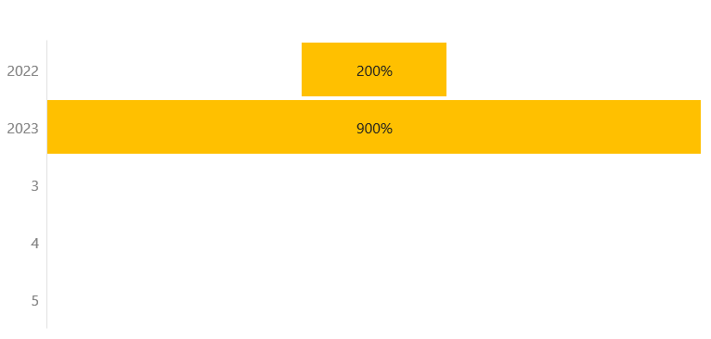
IMANI INORGANICS:
GROWTH & EXPANSION
2024
Insert Your Great Subtitle Here
Expansion: 2024
Global Expansion and Collaboration: Spanish branch
Social Responsibility and Community Impact: Usizo Lomndeni infrastructure expansion
Investment in Research and Development
Customer-Centric Approach
Talent Development and Team Empowerment
Sustainability measures
  Integrate sustainable practices into every aspect of our operations, from production to distribution.
  Embrace green chemistry principles and contribute to a more sustainable future.
Our current position in the South African market
Given our current growth rate of 200% in 2022 and the 900% that we are currently standing on in 2023 Imani Inorganics' growth and expansion strategy for 2024 encompasses innovation, trust-building, international expansion, and social responsibility. By pursuing these strategic goals, Imani aims to solidify its position as a market leader, contributing positively to industries, communities, and the environment.
.

Slide 10



124 Umdoni Road, Amanzimtoti, KZN
+27 64 437 4710
www.imaniinorganics.com
https://www.linkedin.com/company/imani-inorganics.com

